Slide 1
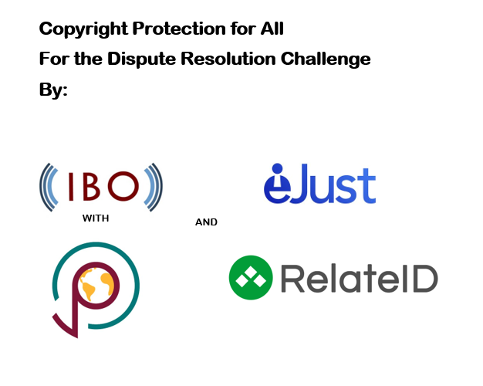


Slide 2
RelateID Blockchain
PeaceTones exists as a trusted organization on the RelateID network. The trust is achieved by consensus on the network by trusted indviduals.
Song
PeaceTones
Emanuel
Kelsey is part of the PeaceTones organization on the RelateID network and has been verified by PeaceTones.
Emmanuel creates a song and uploads the song to the RelateID network. Cryptographic evidence of the song is created. The song belongs exclusively to Emanuel and he may assign rights to it as he pleases.
Emmanuel then creates a smart license for his song for future licensing
Kelsey
License
DISPUTE
Kelsey verifies Emmanuel as a trusted individual and part of the PeaceTones organization
Emmanuel used his smart license to license the music to Agent. Agent violated the terms of the license leading to a dispute.

Slide 3
eJust is a trusted organization (trusted by both RelateID and PeaceTones) running on the RelateID network who arbitrates smart contract disputes.
A trusted eJust representative validates individuals who choose to arbitrate their smart contracts via the eJust organization. Much like Kelsey was validated in PeaceTones.
eJust
eJust Dispute Resolution Process
Claimant provides arguments via eJust which uses RelateID’s blockchain.
The ID’s of the parties are validated by eJust.
Administrator validates request and notifies respondent.
Emmanuel files request for arbitration with the eJust organization.

Slide 4
Arbitrator reviews and discusses the arguments presented.
Arbitrator appointed to the dispute.
Respondent reviews arguments and submits counter arguments.
Respondent may make a final offer to the Claimant in an effort to resolved the dispute.
An Arbitrator trusted by the eJust organization is assigned to the dispute by an Administrator based on the Arbitrator’s level of expertise.
Final offer before award.
The award determined by the Arbitrator and accepted by the Administrator is published to the RelateID blockchain and immutably stored.
An award is drafted by the Arbitrator.
Award drafting.
Formal review by Administrator.
Award acceptable?
YES
Award publication.
NO

